Slide 1


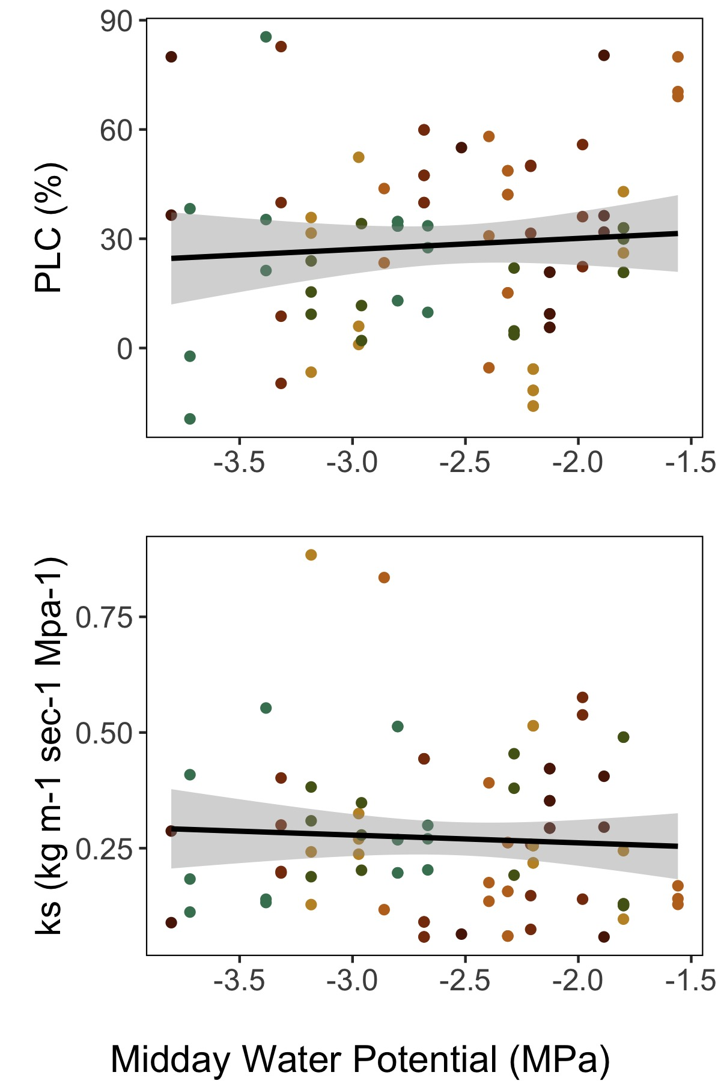
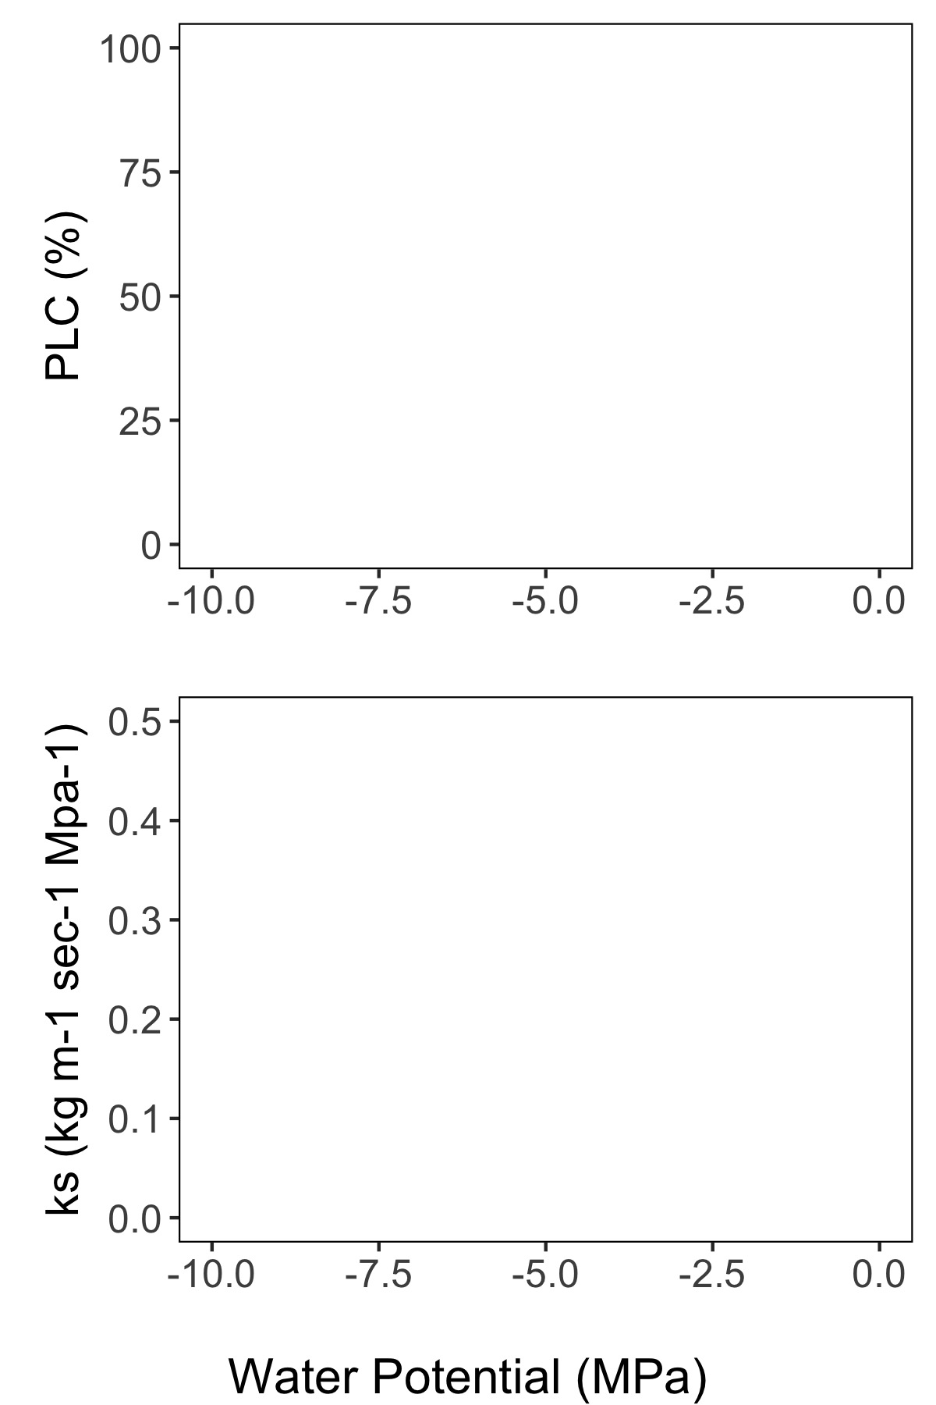
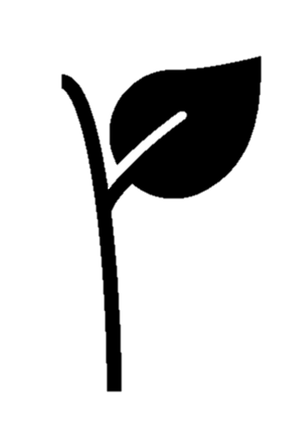
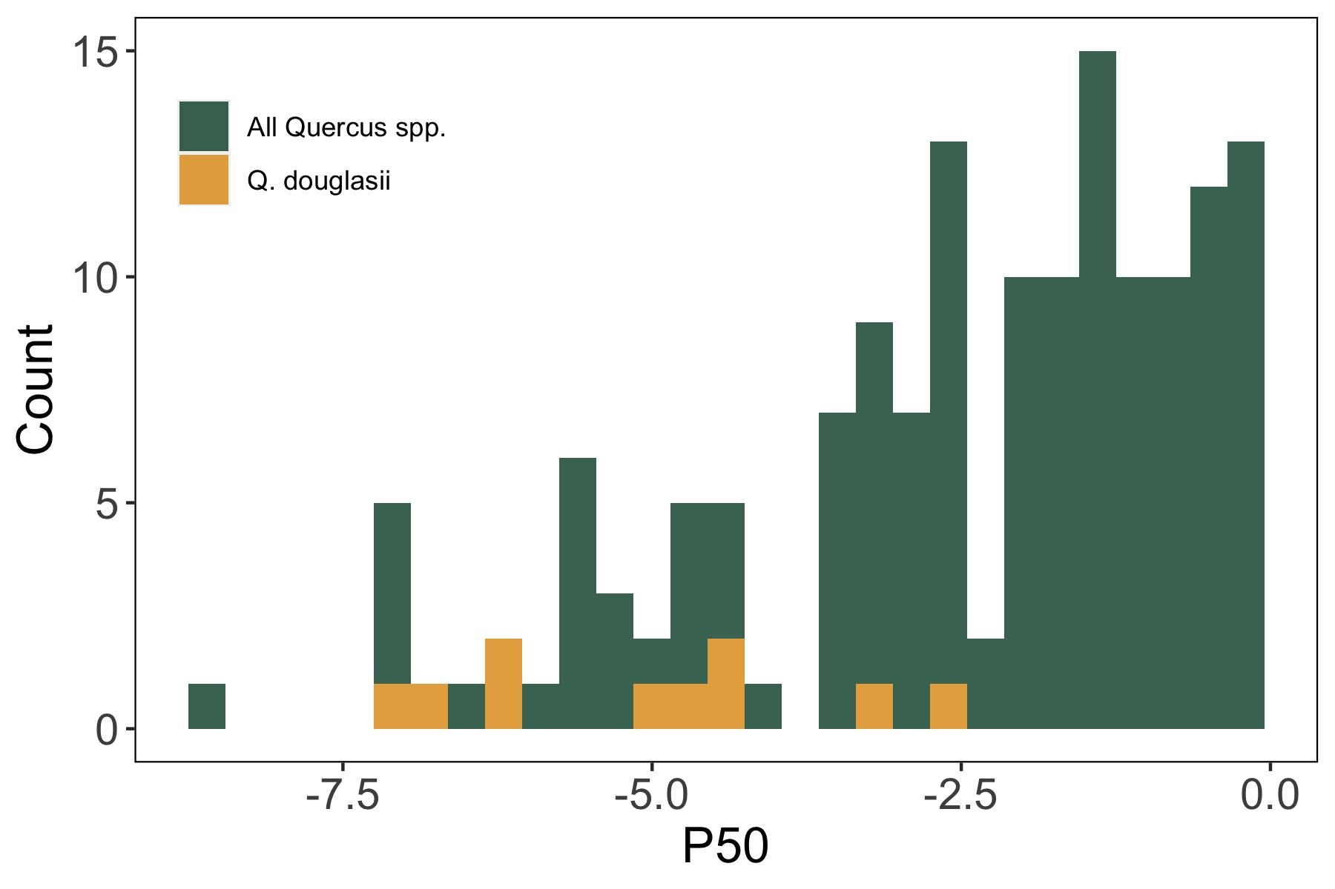
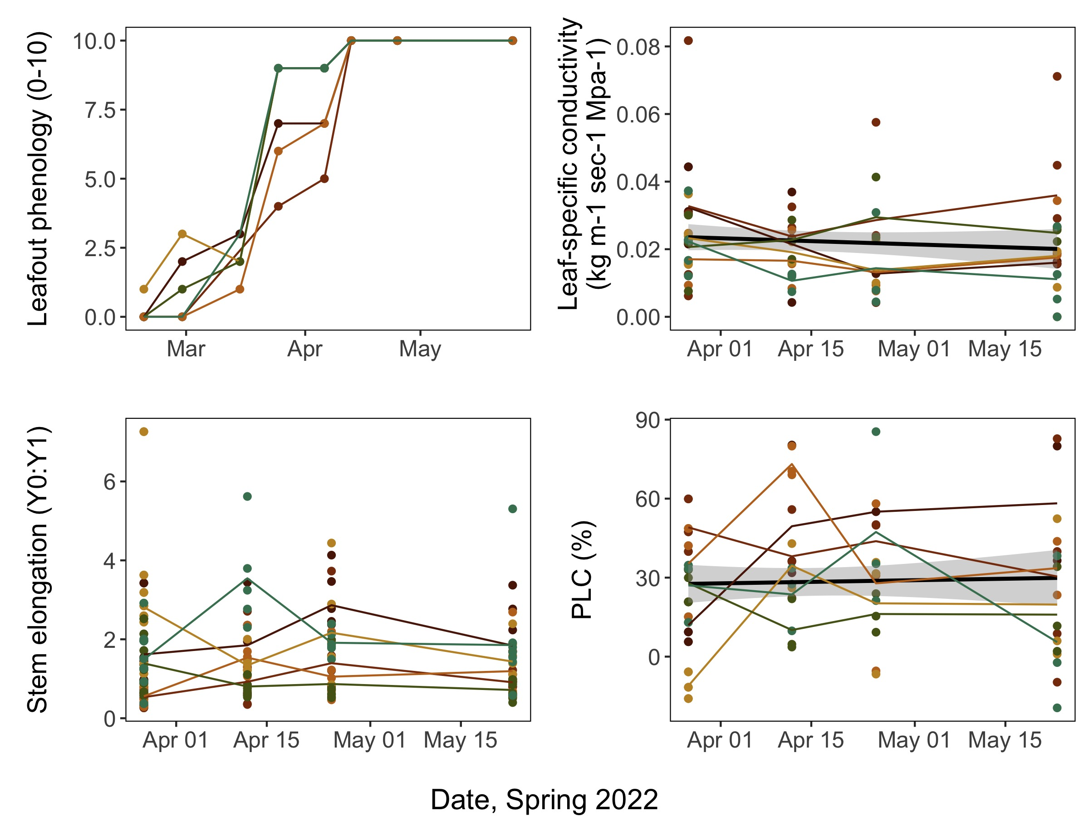

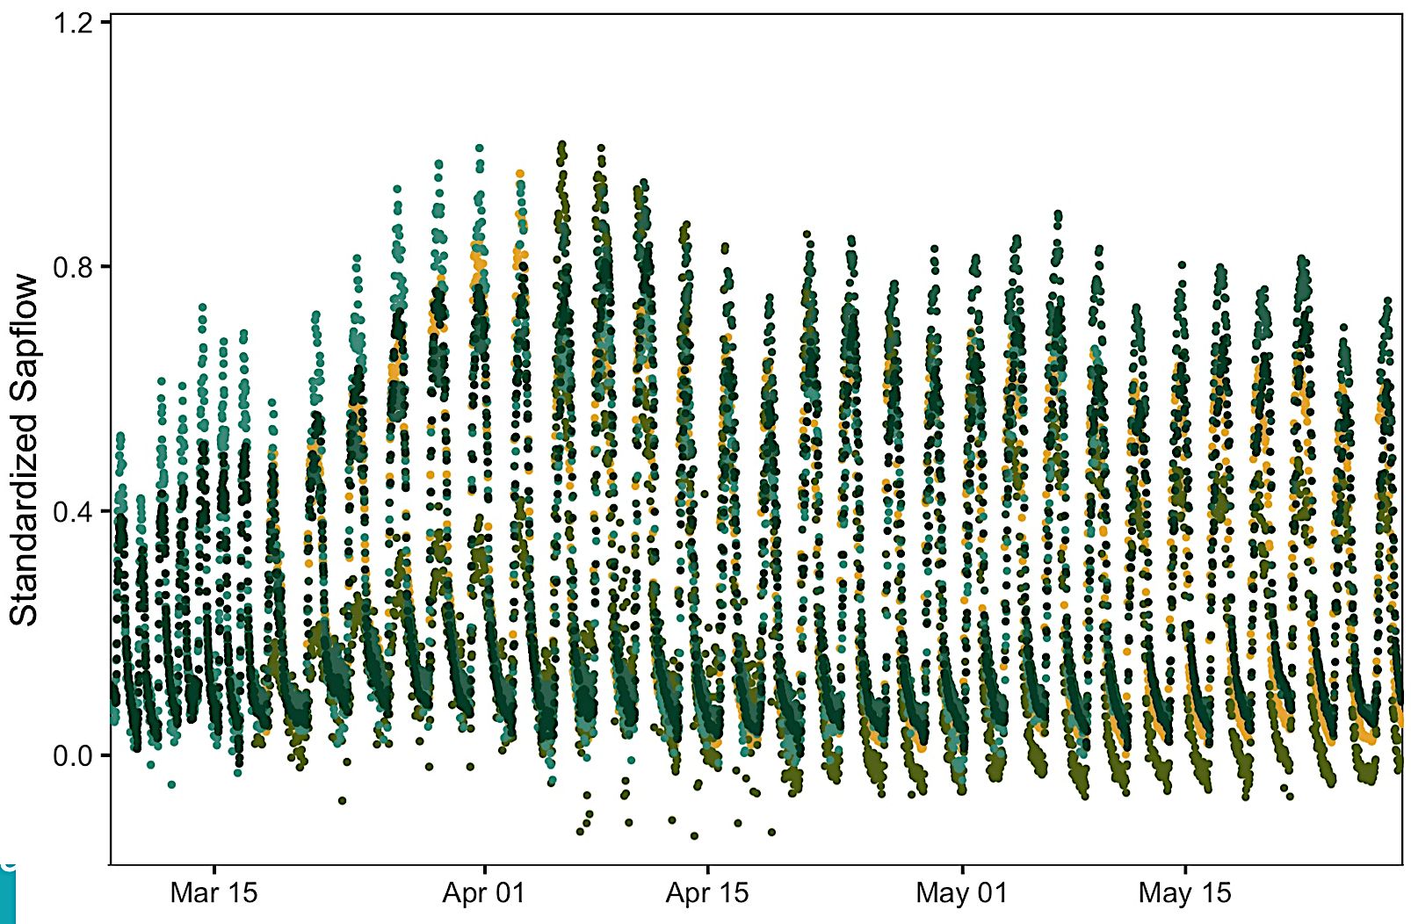
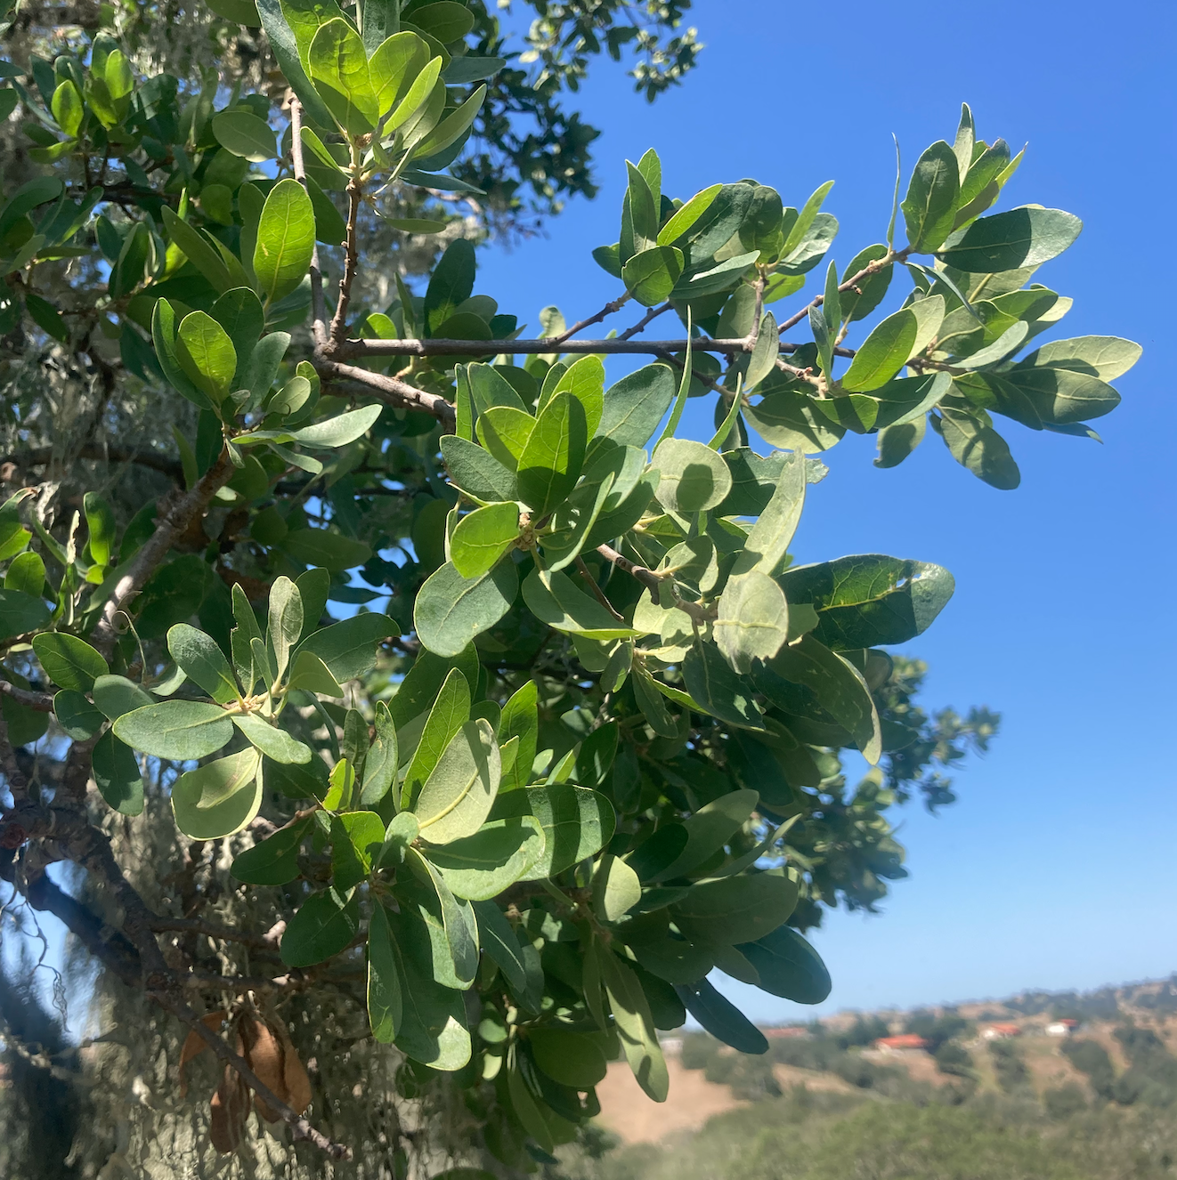

Springtime hydraulics of Quercus douglasii following leafout
Indra Boving, Joe Celebrezze, Leander Anderegg UC Santa Barbara
BACKGROUND
The water potential at which trees lose 50% of their hydraulic conductivity (P50) is a key trait for predictions of drought mortality under future climate change.
In Quercus species, current research shows wide variation in P50 values. This has led to debates on methodology, the extent of plasticity in drought resistance traits, and our ability to effectively incorporate this trait into models of oak tree mortality.
GOALS
RESULTS
Follow changes in hydraulic conductivity during the natural spring to summer dry period to determine ecologically relevant thresholds in conductivity as they relate to phenology and drought status (Fig. 2).
Develop a “natural vulnerability curve” using both branch-level and whole-tree conductance (Fig. 3) to quantify P50 under natural drought conditions.
‘NATURAL VULNERABILITY CURVE’
RESULTS
EFFECTS OF SPRING DRYDOWN
Fig. 3. Relationship between conductivity (ks) and PLC along water potential gradient. Initial results show no significant change in PLC or stem-specific conductivity along an observed water potential gradient from -1.5 to -4 MPa.
SAPFLOW
Fig. 4. Standardized sapflow from trees use for conductivity measurements. Sampling times indicated by yellow arrows and leaves.
Fig 1. Published Quercus P50 values. Data from Choat et al. 2012 and literature search of “Quercus P50”.
METHODS
Further timepoints are needed to fully quantify conductivity and PLC under a wider range of drought conditions, but initial results indicate no severe loss in conductivity during the spring to early summer transition.
P50 likely occurs at more negative water potentials than currently observed in these trees.
We cut large branches from the upper canopies of 6 trees at UCSB’s Sedgewick Preserve and immediately recut these under water.
We measured ks_{nat} and ks_{max} using the vacuum chamber method (Kolb et al. 1996). Ks_{max} was determined after 12 hours of vacuum infiltration and used to calculate PLC.
Whole-tree conductance was monitored on the same trees using sapflow sensors and periodic measurements of midday and predawn water potentials.
Fig. 2. Phenological changes (leafout status and new stem elongation) up to and during the spring to summer transition. Corresponding leaf-specific conductivity (n = 36) and percent of maximum conductivity (PLC, n = 18) for four timepoints following spring leafout.
References:
Choat B, Jansen S, Brodribb TJ, Cochard H, Delzon S, Bhaskar R, Bucci SJ, Feild TS, Gleason SM, Hacke UG, et al (2012) Global convergence in the vulnerability of forests to drought. Nature 491: 752–755
Kolb KJ, Sperry JS, Lamont BB (1996) A method for measuring xylem hydraulic conductance and embolism in entire root and shoot systems. J Exp Bot 47: 1805–1810
Li X, Xi B, Wu X, Choat B, Feng J, Jiang M, Tissue D (2022) Unlocking Drought-Induced Tree Mortality: Physiological Mechanisms to Modeling. Frontiers in Plant Science 13:

